Slide 1
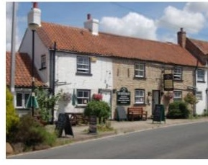
Exelby Green Dragon Community Pub Ltd
Annual Members’ Meeting
7.00pm 23rd April 2026

Slide 2
Agenda Items 1-4
1. Welcome and introductions
2. Apologies for absence
3. Declaration of Quorum
4. Notes of Annual Members meeting 2025 and matters arising

Slide 3
Agenda Item 5
Performance for the year

Slide 4
Previous Year
No capital works
Share Sales and Repurchases
Medium Term Budget outlook 2025-2029

Slide 5
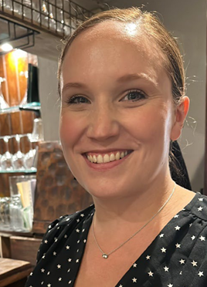
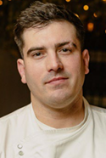
Sam and Becky

Slide 6
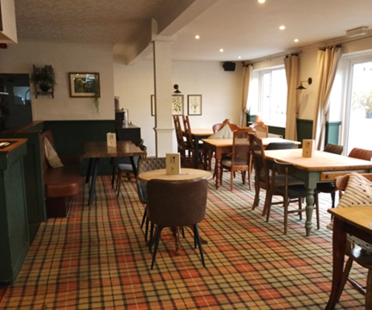
Restaurant

Slide 7
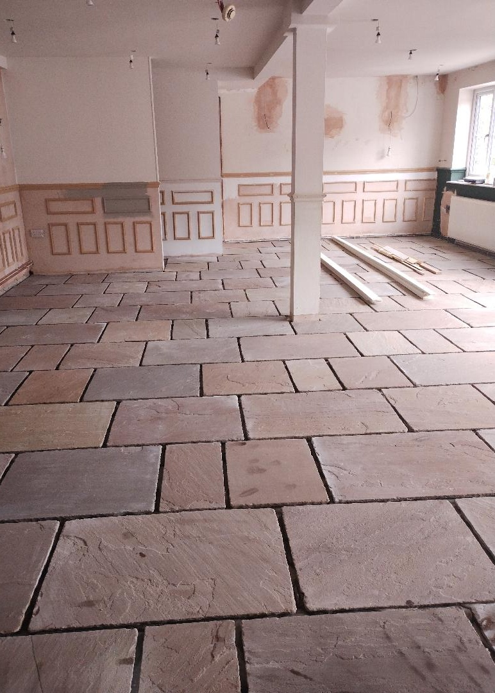
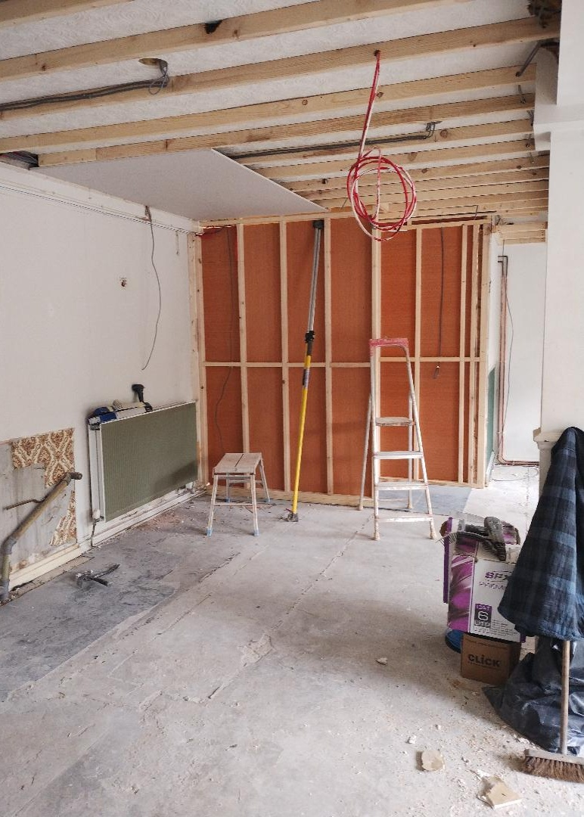
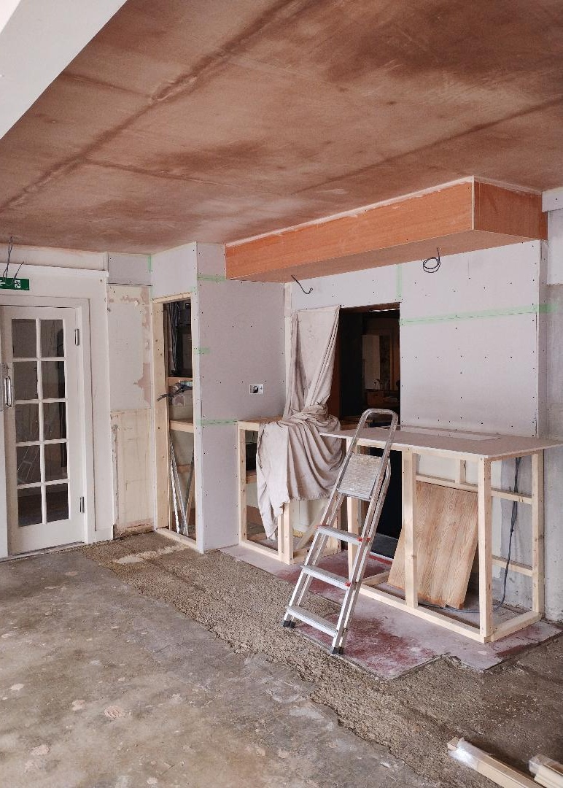
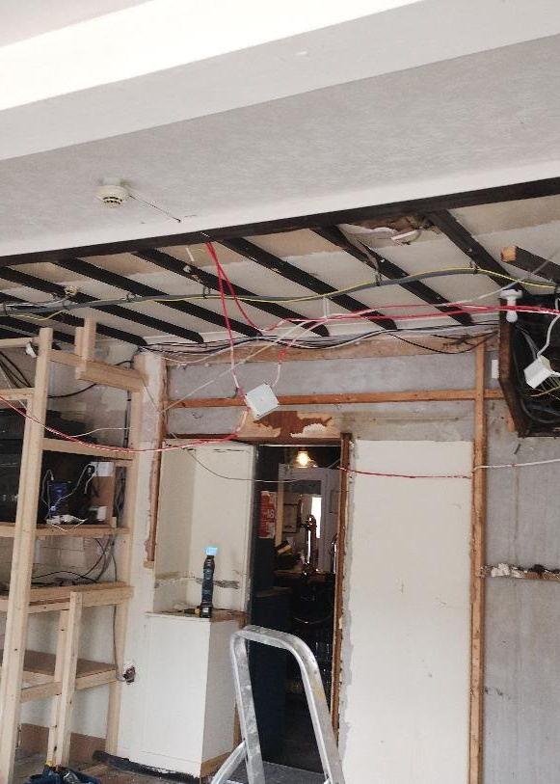
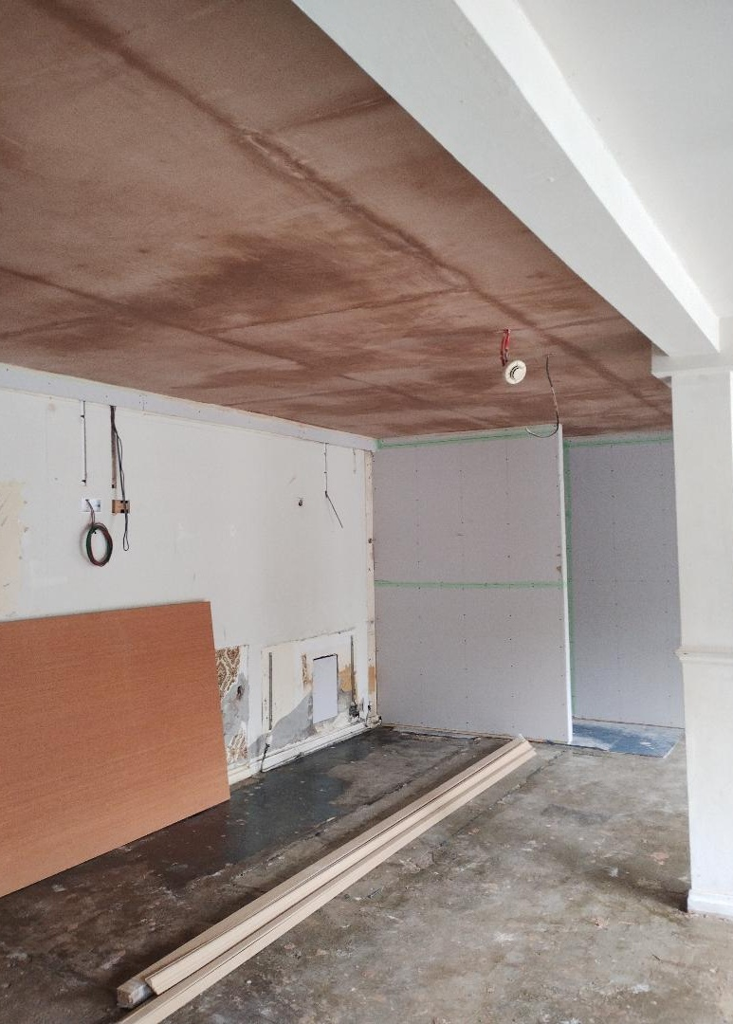
Restaurant

Slide 8
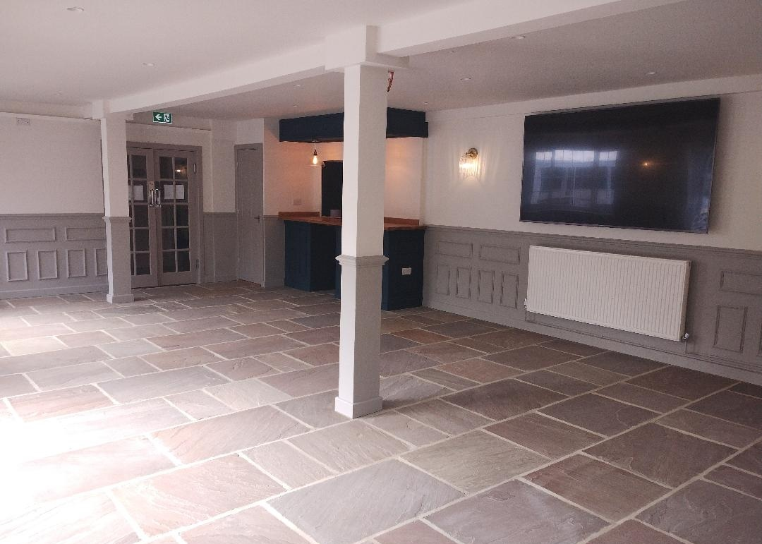
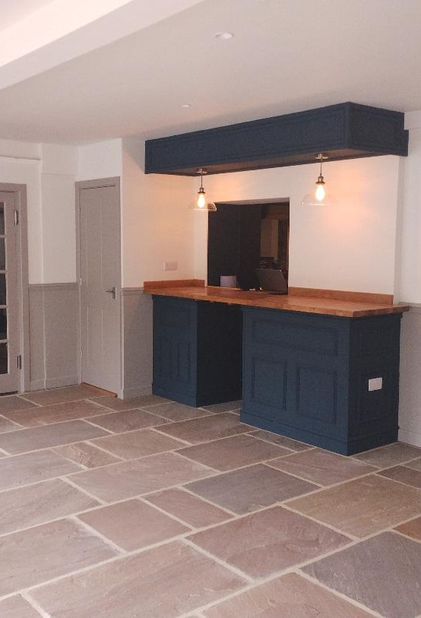
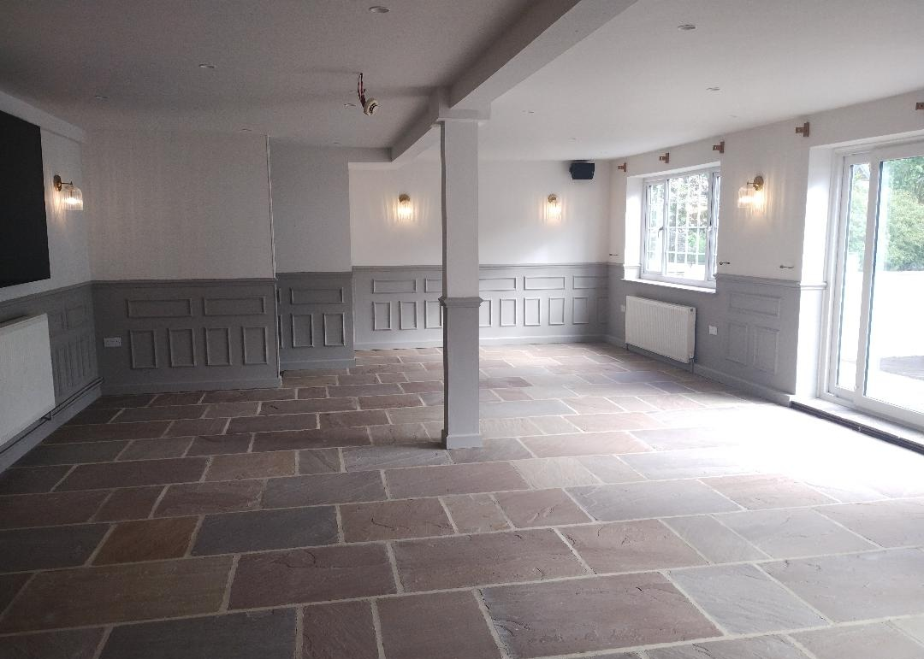
Restaurant

Slide 9
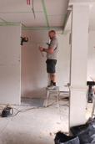
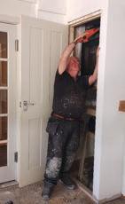

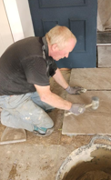
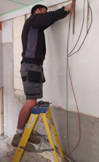
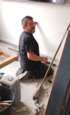
Restaurant

Slide 10
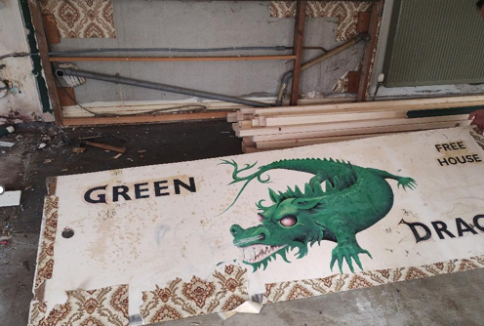
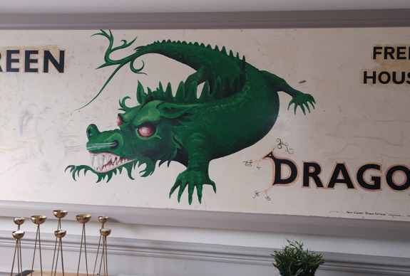
Restaurant

Slide 11
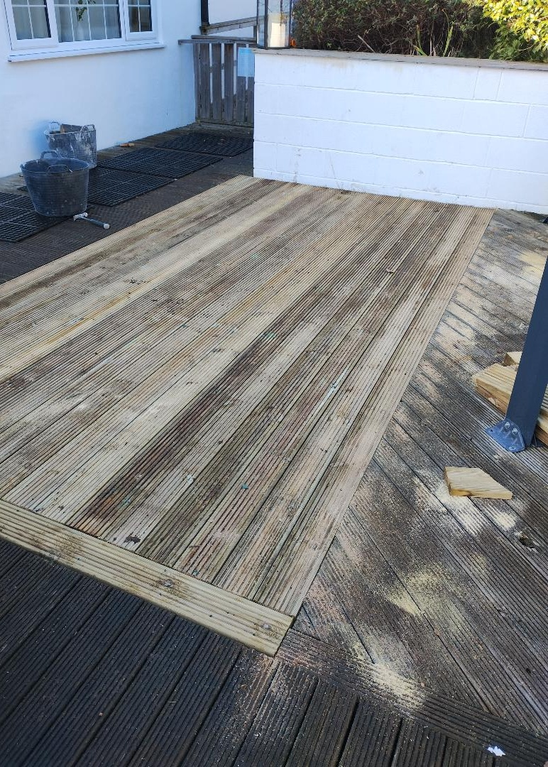
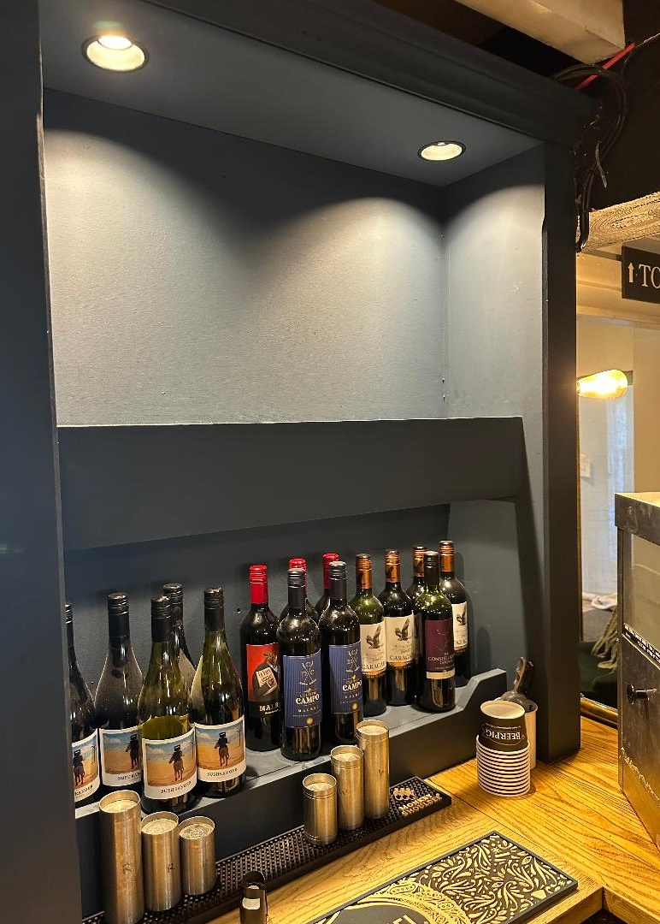
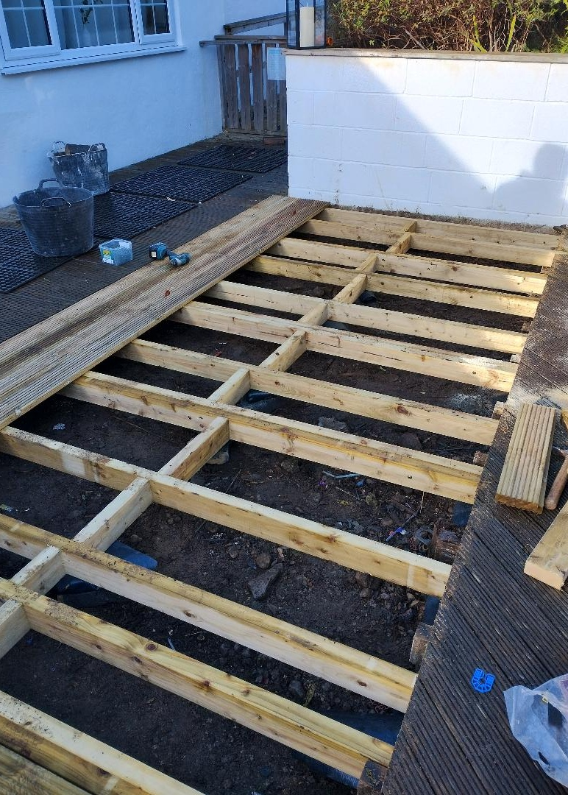
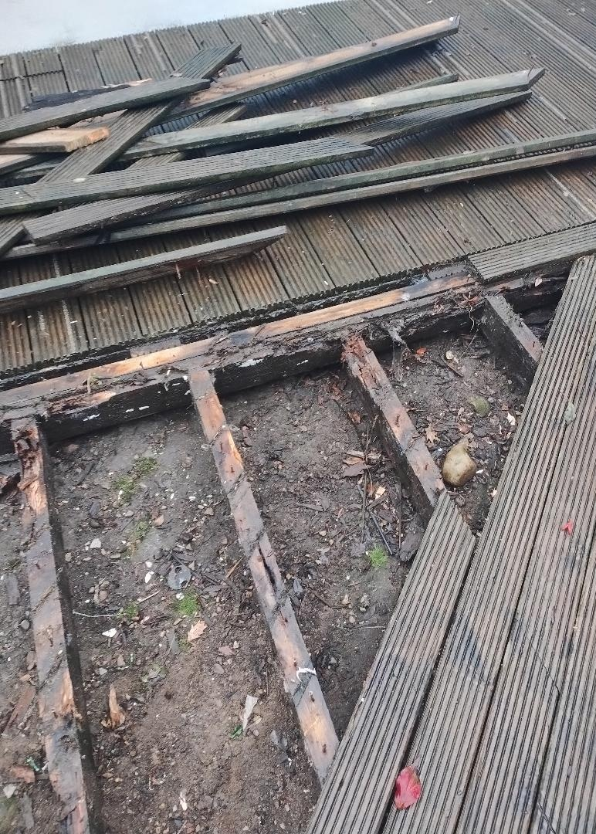
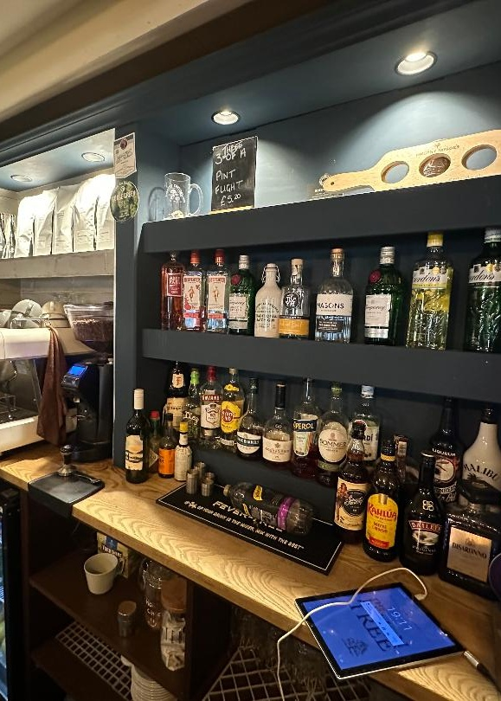
Decking
Small Works
Bar lights

Slide 12
Kitchen works
Extraction hood upgrade
Replacement dishwasher
Replacement countertop fridge
Replacement deep fat fryer
Oven – repairs and water softener

Slide 13
Overall Capital
Position
Income
Total | 474,590
Outgoings
Purchase/fees | 203,260
Refurbishments | 259,330
Balance | 12,000
Maintain a prudential balance of £12,000

Slide 14
Capital and Revenue Funds
Funds | 2025
Capital balance | 12,000
Cottage Turnover Fund | 2,442
Community Fund | 215
Revenue Fund Balances | 7,204
Sub Total | 21,861
Less
Prudential balance, earmarked Funds and Share Repurchase Fund | 21,337
Investment Funds available | 524

Slide 15
Budget Outlook
 | 2026 | 2027 | 2028 | 2029 | 2030
Anticipated Nett | 9,000 | 11,000 | 21,500 | 24,000 | 24,000
Member interest | 4.5% | 5% | 5% | 5% | 5%
2026 - 2030

Slide 16
Budget Outlook
No share interest for 2025
Retain prudential balance of £12,000
Retain repairs and renewals contingency of £5,000
Fund identified Renewals
Fund existing share repurchase requests
Set aside funds for cottage and pub relet
Loan repayment to end March 2028
All major projects in original business plan complete
Plan to 2027
(Shareholders Meeting
20th January 2026)

Slide 17
Shares
Share Repurchase Fund to Dec 2025
Annual contributions | 30,000.00
Sales | 25,500.00
Sub Total | 55,500.00
Repurchases | 54,000.00
Fund balance | 1,500.00
Outstanding requests | 4,500.00
Unfunded liabilities Dec 2025 | -3,000.00
Sales and Repurchase requests
Anticipated 2026 contribution to fund | 3000.00

Slide 18
Share Repurchase Requests
Requests dealt with in the order received
Fund existing share repurchase requests by January 2027
No further requests be dealt with in 2026
Moratorium remain in place until at least end 2026
Indicative repurchase limit for 2027 at £2000 if affordable
Reduce number of shares in circulation by 50
Share sale income accrues in the Repurchase Fund to offer flexibility/assist cash flow
Estate transfers be encouraged
Plan to 2027
(Shareholders meeting 20th January 2026)

Slide 19
Capital Works
Review
Building Renewals
  Lean to roof
  Access door
  Decking
Kitchen equipment
Short term requirements

Slide 20
Business Planning
Medium Term Budget Outlook 2026-2030
  Financially sound
  Original loan of £50,000 paid off Jan 2024
  New loan of £45,000 (to March 2028)
  Repairs and Renewals Fund
  Share repurchase Fund
  Future Share interest payments
Risk Assessment

Slide 21
Interest Payment to Shareholders
Last Year
  4% for year to Dec 2024
This year
  0 % for year ending 31 December 2025

Slide 22
Management Committee
Meetings
Continues to meet regularly
Newsletters (when there is something to say!)
Up to date information www.exelbygreendragonpub.co.uk
Have we got your bank details

Slide 23
Agenda Item 6
Presentation of Accounts to
31st December 2025

Slide 24

Annual Accounts
Year to Dec 2025
Accountants report that :
financial statements agree with our records
financial statements comply with requirements
financial criteria meet the requirement for not having a full audit
Accounts are compliant

Slide 25
Headlines
Headlines
Total assets after current liabilities - £293,582
Profit/Loss for the year - £2,702
Five-year revenue plan 2026-30
  Second loan paid off 2028
  Future profits continue to build Repairs & Renewals and Share Repurchase Funds
  Members’ interest has potential to grow to 4.5% for 2026 and 5% for 2027
Accounts are compliant

Slide 26
Agenda Item 7
Resolution not to appoint auditors
Members note that Exelby Green Dragon Community Pub Ltd (the society) is entitled to exemption from the requirement to obtain an audit under section 84 of the Co-operative and Community Benefit Societies Act 2014.
Members confirm that they do not require the society to obtain an audit of its financial statements for the period ending 31 December 2025 in accordance with the Act and that they are content to rely upon the Independent Accountant's Report.

Slide 27
Agenda Item 8
Membership

Slide 28
Share Repurchases and Sales
Share Sales and Repurchases | 2024 | 2025
Repurchases | 39 | 49
Sales | 23 | 8
Net effect for the year | -16 | -41
Net trading for the year | -£8,000.00 | -£20,500.00
Total Shares | 500
Shares repurchased and ‘withdrawn form sale’ | 50
Anticipated shares in circulation by end 2026 | 450

Slide 29
Shareholders
 | 2024 | 2025
Shareholder numbers | 156 | 153
Share capital | £225,500 | £221,500
Geographically (by shares held) Exelby Local Area Wider Yorkshire Other | 43% 31% 9% 17% | 49% 22% 16% 13%

Slide 30
Agenda Item 9
Election of Management Committee

Slide 31
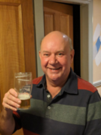
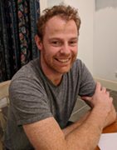
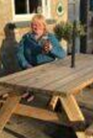
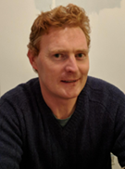
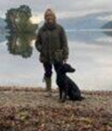
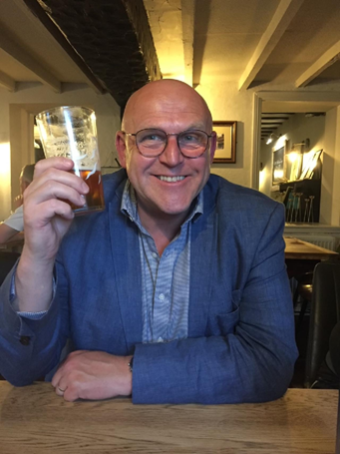
Management Committee
Directors
Serving until 2027
Peter Simpson – Chair George Cornwall-Legh – Vice Chair Alasdair Campbell Jim Haigh
Serving until 2028
Linda Graham (Treasurer) Lucinda Riddell (Secretary)
Resignations
John Walker (December 2025) Ali Bearpark (June 2025)

Slide 32
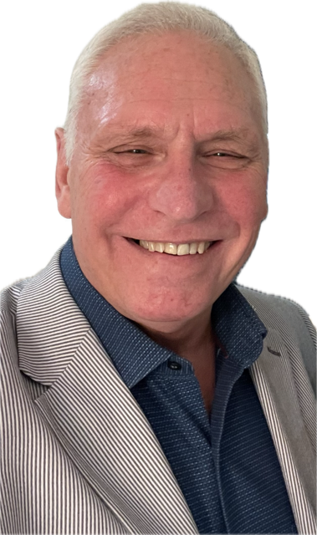
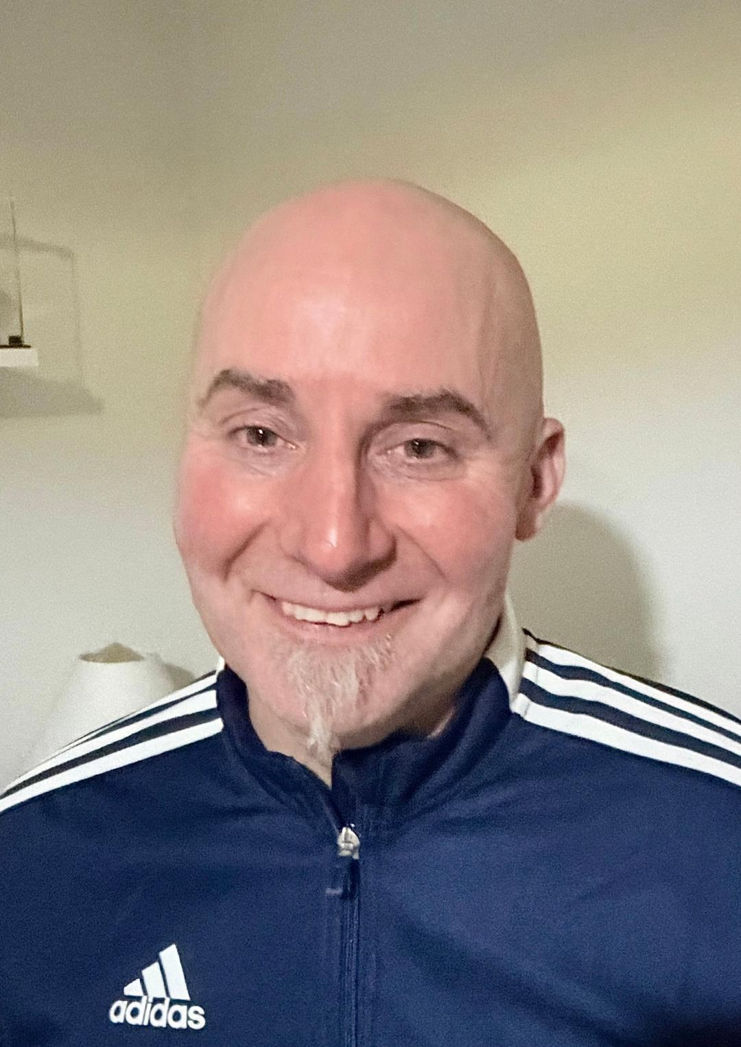
Management Committee
Directors
Coopted and standing for election until 2029
Ian Vickers (January 2026)
Coopted
Paul Johnston (June 2025)

Slide 33

Any other business

Slide 34

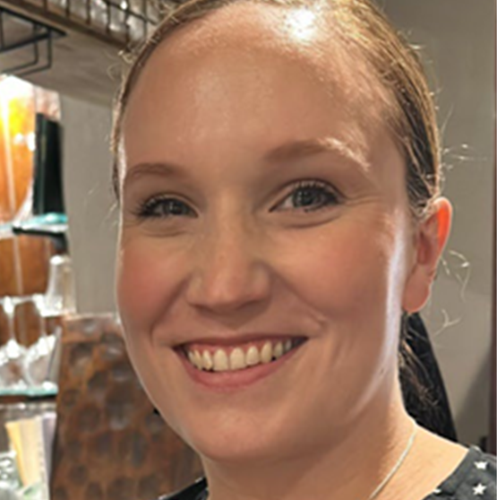
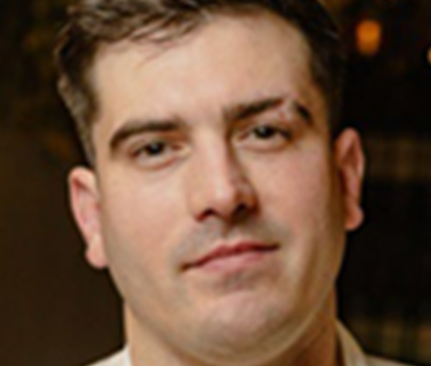
Up to date information
www.exelbygreendragon.co.uk
Facebook:- Exelby Green Dragon Group

